Slide 1
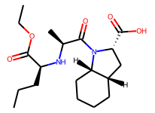
TECS PhD Machine Learning Rotation:
What causes a drug/molecule to be toxic and can we predict it?
ML
Not Toxic
😊
Dataset: “ Toxicology in the 21st Century” (Tox21):
Qualitative toxicity, 8k compounds, SMILES structures,
12 assays:
“NR-XXX” - Nuclear receptor signaling bioassays results
“SR-XXX” - Stress response bioassays results
Problem: Classification: toxic/non-toxic
Task:
Have a look at your dataset, are there any patterns to it?
What sort of chemical features are associated with toxicity?
Train a series of models to predict toxicity, which is the best?

